Slide 1
Coon Valley Lutheran Church Bell Tower
Pictures acquired May of 2023

Slide 2
Above Organ Pipes
Access through hatch in the organ room.
Photo faces street.
Ladder to upper bell tower

Slide 3
Sanctuary attic
Opposite from chair and windows

Slide 4
Looking down from tower ladder. Entry hatch from organ room lower right.

Slide 5
Ladder to Bell

Slide 6
Bell mount at top of ladder

Slide 7
Small opening at top of ladder to bell mount.

Slide 8
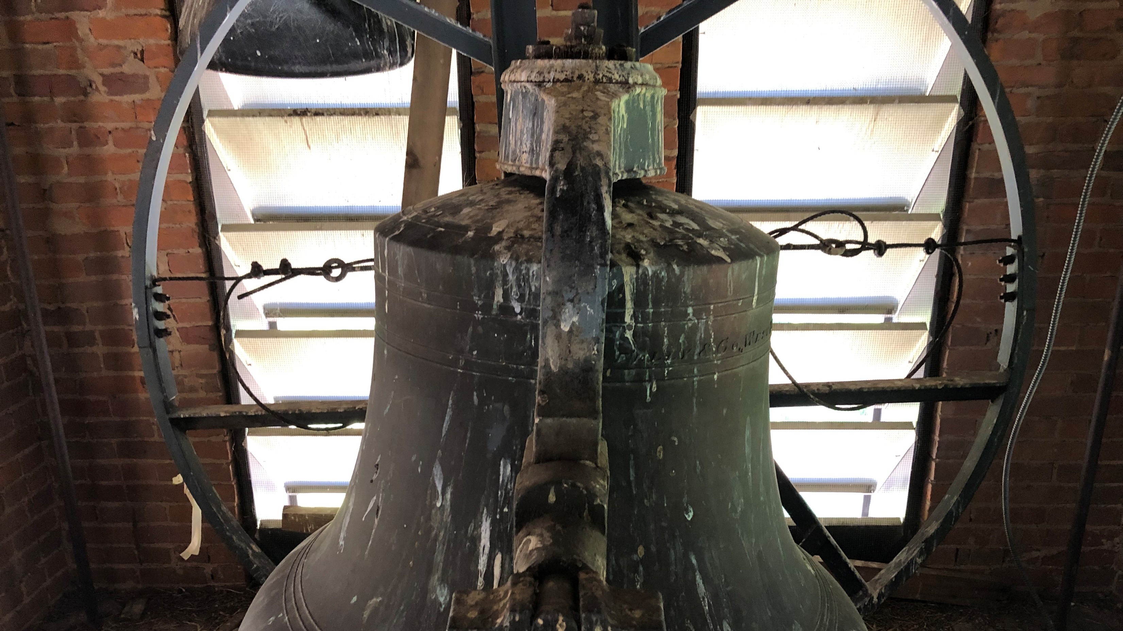

Slide 9
The wheel that swung the bell with a rope is now stationary.

Slide 10
Clapper in mouth of bell no longer used

Slide 11
Electric powered striker is what we hear now

Slide 15
Meneely & Co., East Troy, NY. 1883
Made at Meneely Bell Foundry founded by Andrew Meneely in 1826.

Slide 17
Carillon speakers

Slide 18
Found in bell tower

Slide 19
Tools in bell tower

Slide 20
The End
A bell tower resident who was not harmed in the making of this presentation.

